Slide 1








PreDisc eHealth
From continuity of care to a digital platform
https://predisc.evidagroup.es

Slide 2
Table of contents
1
The challenge of PreDisc
2
Where the platform fits?
3
Digital workflow
4
Scope
5
Architecture vision
6
Technical implementation
7
Support materials
8
What the contribution leaves behind?

Slide 3
1.-The PreDisc challenge
Continuity of care is the central challenge
After discharge, physical activity, nutrition and follow-up must continue in daily life.
Professionals
CONTINUITY
Patients
Experts who assign recommendations and carry out follow-up
People who require follow-up in their daily lives
The platform was created as a digital component to support that continuity in community and rural settings.

Slide 4
2.- Where the platform fits?
Professional Area
Manages patients and resources
Ecosystem PreDisc
A digital component within a broader healthcare, research and communication project.
Patient Side
Provides controlled access to assigned material
Open Area
Provides educational content for a wider audience

Slide 5
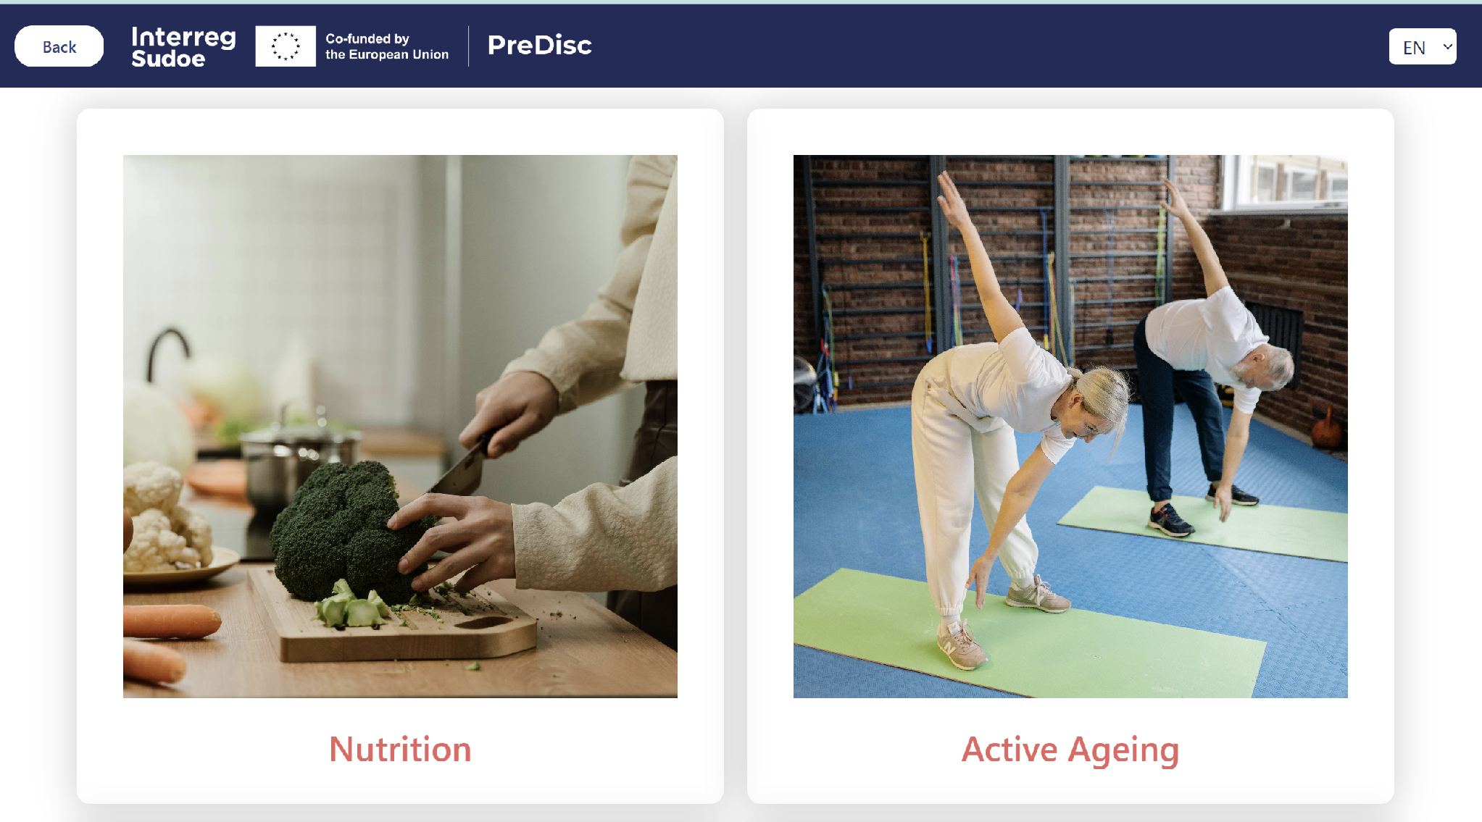

Slide 6
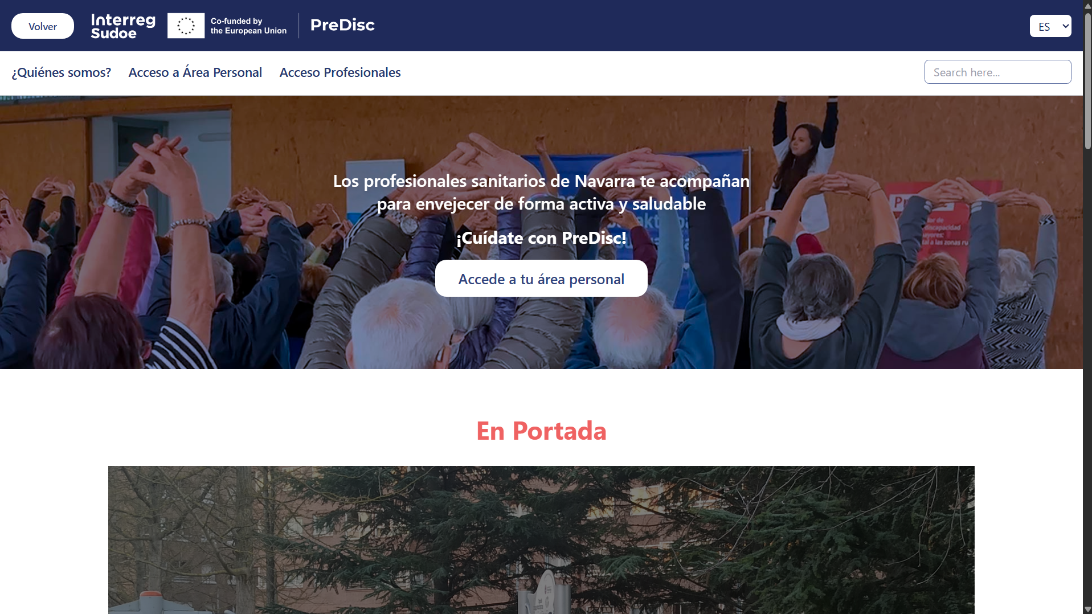

Slide 7
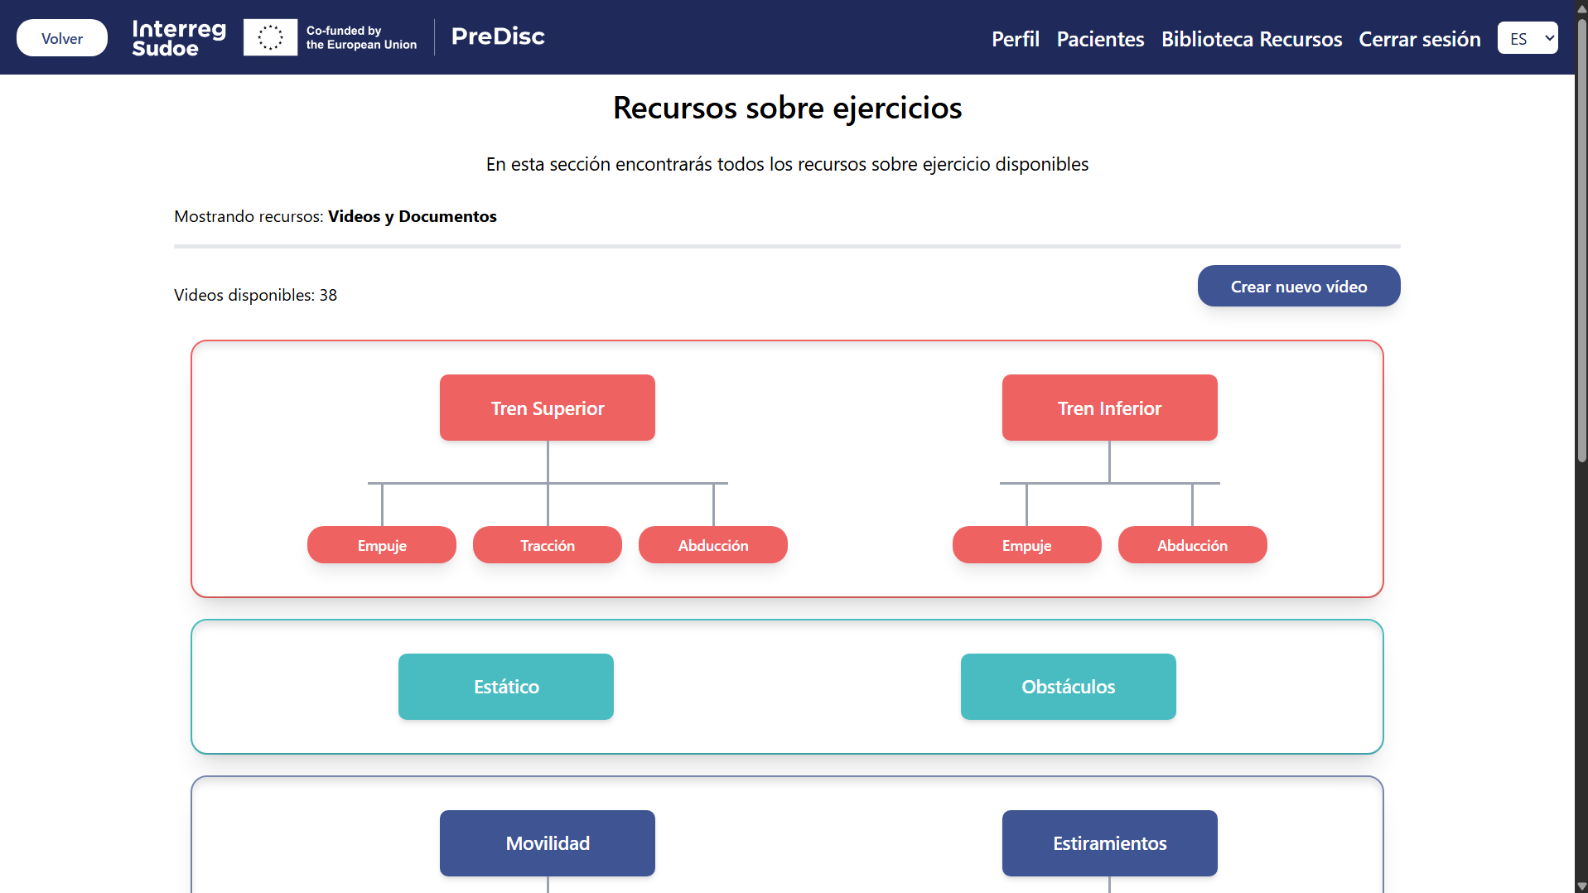

Slide 8
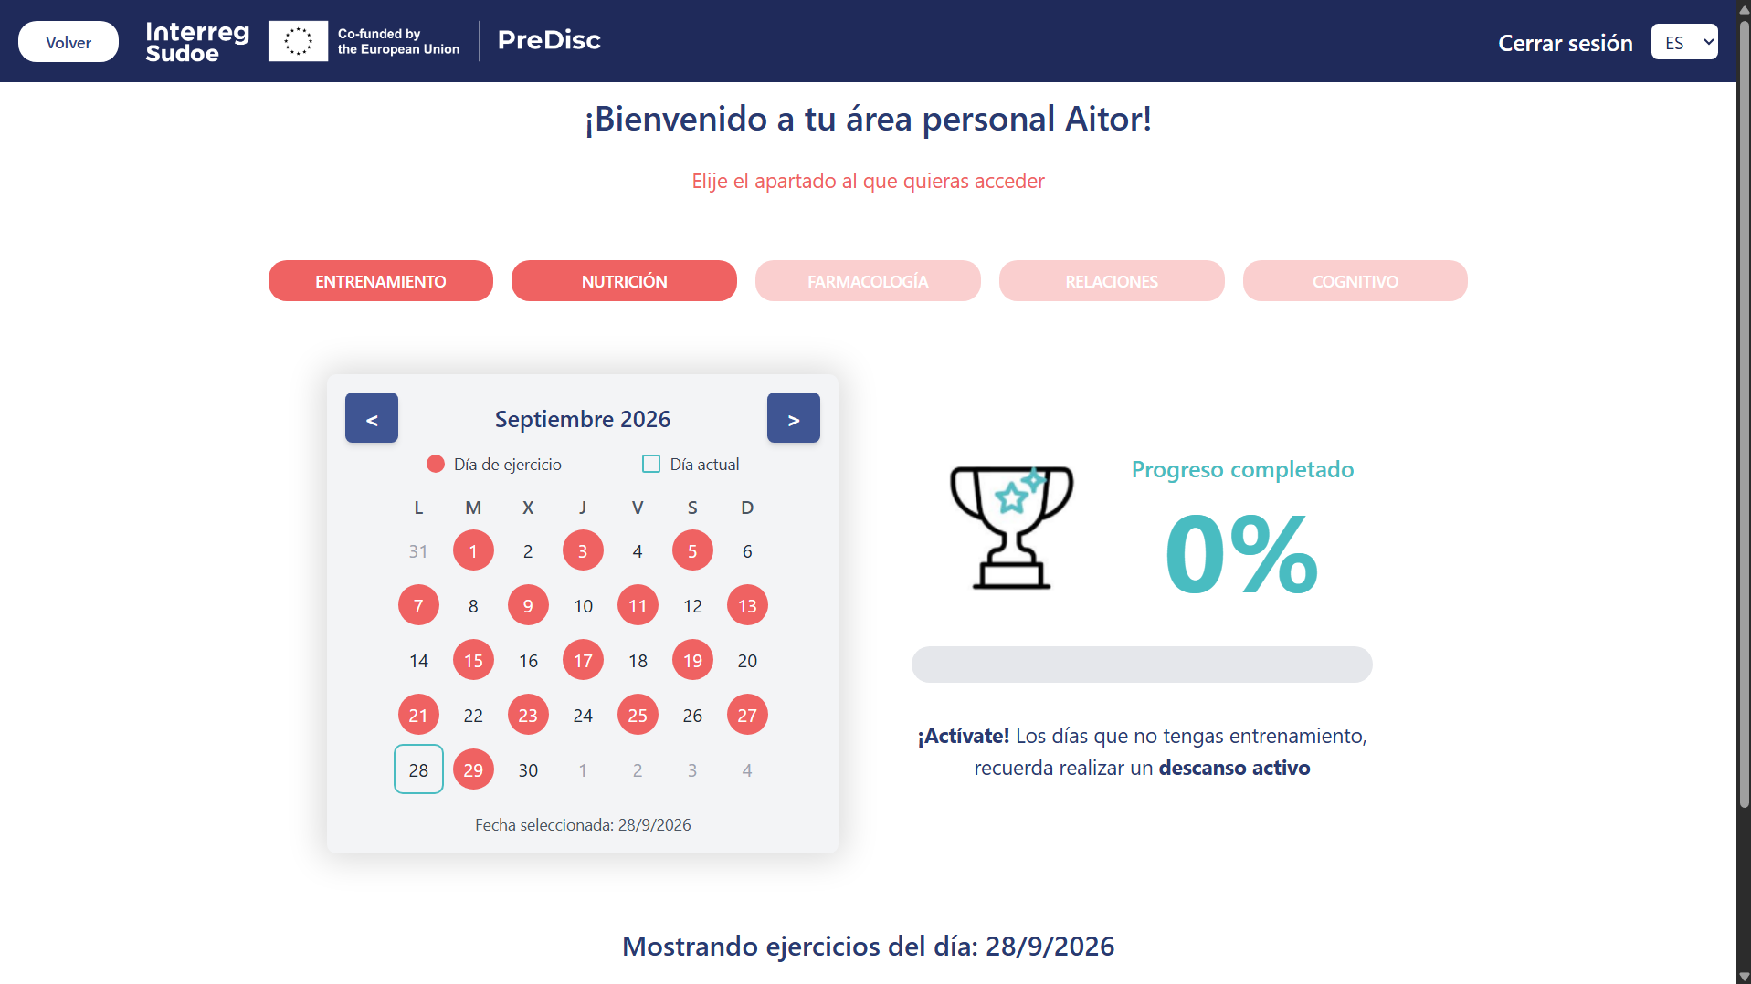

Slide 9
3.- Digital workflow
From care needs to digital workflow
1
2
3
4
Professional
Resources
Assignment
Access
Manages patients and needs.
Organizes documents and videos.
Connects content to a specific patient
The patient accesses it from their personal area.
The platform organizes roles, permissions, assignments and patient-specific access.

Slide 10
4.- Scope
Functional areas
1
Users
2
Physical Activity
Separation of access and profile management. Distinguishing between professionals and patients.
Supports resources related to exercise and movement.
3
Nutrition
4
Open Area
Focused on nutritional recommendation resources.
Enables publication of public content such as news, questionnaires or documents.
5
Deployment
The platform has been deployed in production on a server.

Slide 11
5.-Architecture vision
A modular architecture
The key idea is not the specific technology, but the internal organization.
Explanation
Advantages
Functional Domains
Organization
Users, activity, nutrition and open area.
Easier to understand where each part of the system belongs.
Modularity
Responsibilities
Growth
Each part has a clear function.
Prepared for possible future growth.

Slide 12
6.- Technical implementation
Main components of the platform
The technology is understood by function: server logic, web interface, data, application access and deployment.
Backend - Django
Frontend - React
Access and languages
Server logic and main operations.
Web interface for professionals, patients and the open area.
Web browser access and a translated interface so the platform can be used by the main partners.
Database - MySQL
Deployment - Docker
Information persistence.
Helps deploy the platform in different environments.

Slide 13
7.- Support materials
P
Professional user manual
User manuals and explanatory videos
Link: url
P
Patient user manual
The platform is accompanied by materials designed to facilitate use, transfer and consultation by users.
Link: url
V
Explanatory videos
Link: url

Slide 14
8.- What the contribution leaves behind?
A synthesis of the value delivered
Structured platform
Connected flows
Adapted to the context
A coherent digital support for PreDisc with different functional areas.
Clear relationship between professional, resources and patient.
Enables customization and adaptation for each partner.
The result is not just screens: it is a clear, understandable and coherent modular foundation within the PreDisc ecosystem.

Slide 15
A continuity-of-care need has been turned into a structured, modular and adaptable eHealth platform.
Thank you

